Slide 1
Public Key Cryptography
By: Evan Tobin
Discrete Mathematics CS131
Product vision | Pitch deck
2022

Slide 2
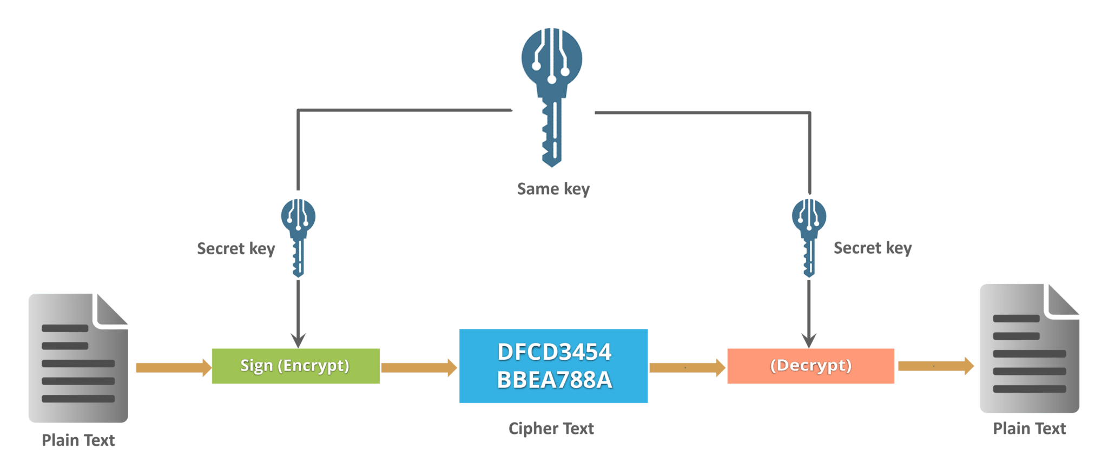
What is Cryptography?
Scrambling a message into incoherent text .
Descrambling that text one it is received.
Product vision | Pitch deck
2022

Slide 3

Cryptography examples…
Cryptography is used for all of the following situations:
Electronic banking
Website authentication
Time stamping
And much more…
Product vision | Pitch deck
2022

Slide 4
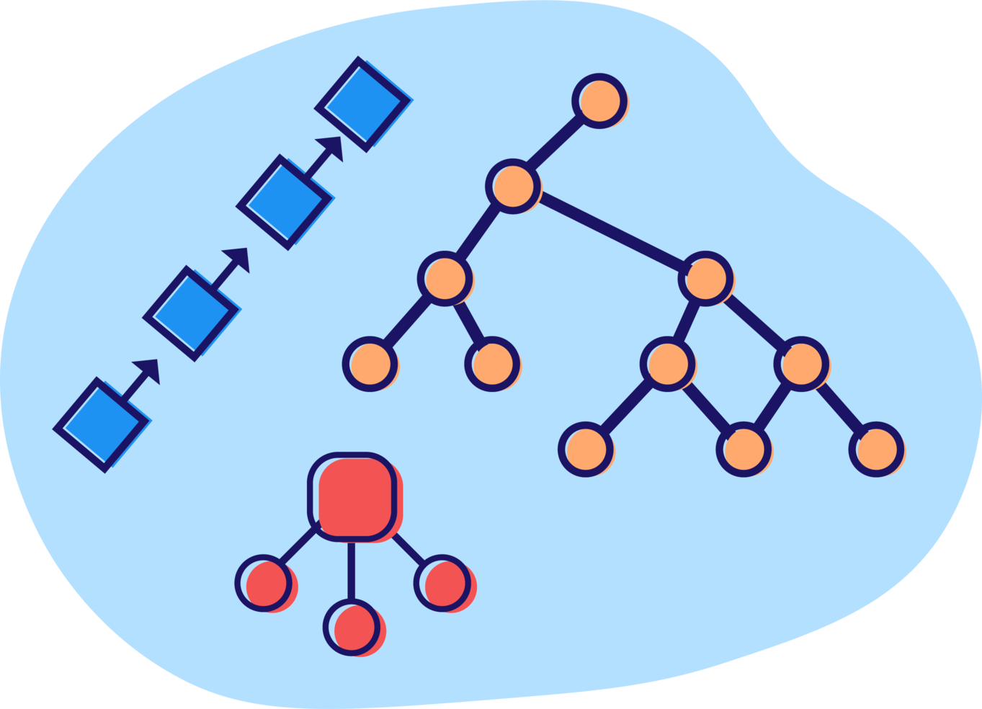
Types of Cryptography
Three main types of cryptography:
Symmetric Key Cryptography
Hash functions
Asymmetric Key Cryptography
Product vision | Pitch deck
2022

Slide 5
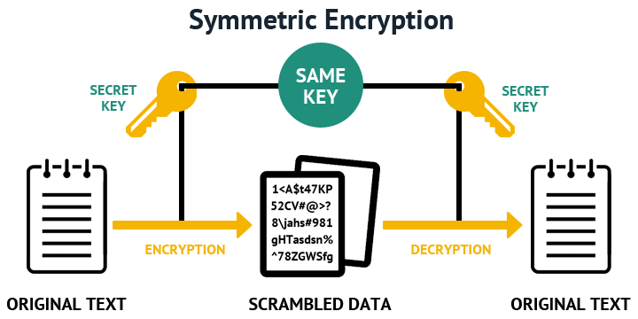
Symmetric Key Encryption
The message is encrypted and decrypted with the same key.
Product vision | Pitch deck
2022

Slide 6
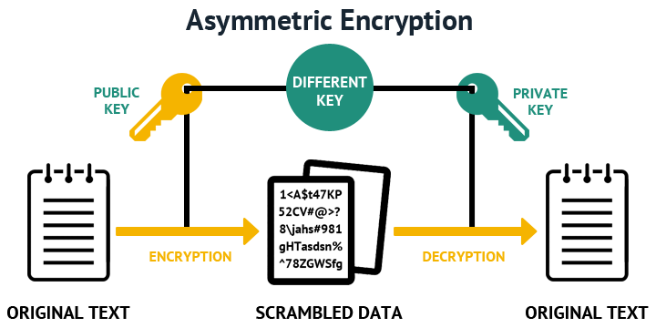
Asymmetric Key Encryption
The message is encrypted with the public key and decrypted with the private key.
Product vision | Pitch deck
2022

Slide 7




Alice
Bob
Private Key
Private Key
Public Key
Public Key

Slide 8

Alice
Bob
Public Key
Private Key
Private Key
Public Key
Public Key

Slide 9
Alice
Bob
Private Key
Private Key
Public Key
Public Key

Slide 10
Alice
Bob
Private Key
Private Key
Public Key
Public Key

Slide 11
Alice
Bob
Private Key
Private Key
Public Key
Public Key

Slide 12

RSA ENCRYPTION
Algorithm developed by:
Rivest, Shamir, and Adleman
701,111 ➝
907 x 773
907 x 773 ➝
701,111

Slide 13
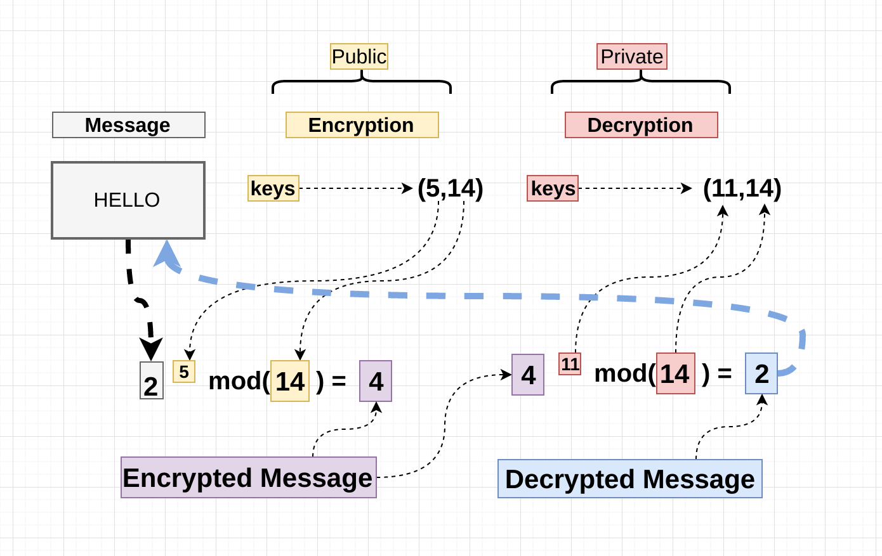
Step 1: Take two large primes:
p and q
Example:
p = 2, q = 7
e = 5
d = 11
Step 2: Compute their product:
n = p x q
n = 14
Step 3: Choose a number e that is less than n and relatively prime to (p-1)(q-1).
Step 4: Choose a number d, such that:
d * e % [(p-1)(q-1)] = 1

Slide 14

Thank you for listening!
By: Evan Tobin

